Slide 1

Prisma Health Benefit Plan Provider Education
2019

Slide 2
Allegiance and Prisma Health
Effective January 1, 2019
We are excited to announce that there are significant changes coming for the participants that will be covered under Prisma Health’s (formerly GHS and Palmetto Health) health benefits plans in 2019. The new benefits plans will be administered by Allegiance TPA using the Prisma Health Midlands Network and the Prisma Health Upstate Network, and will offer significant incentives for covered health plan participants to utilize Prisma Health Midlands Network and the Prisma Health Upstate Network participants for their care.

Slide 3
Who is Allegiance?
Our History
Originally founded in 1980, Allegiance has administered Self-Funded Health Plans for more than three decades.
    Over 150 clients across the country representing more than 400,000 lives.
    Clients include hospital systems, school districts and government organizations, insurance trusts, and MEWAs.
    Claims processing, customer service, enrollment, and all other services are coordinated from our corporate office in Missoula, MT.
Allegiance became a wholly-owned subsidiary of Cigna in 2008 enabling us to offer the flexibility and customized service of our TPA model alongside Cigna’s extensive network and analytic products.

Slide 4

Allegiance and Prisma Health
Our Relationship
Allegiance is the third party administrator (TPA) for the Prisma Health plans in South Carolina.
Team members and their families can access one of four plan designs.

Slide 5
Working with Allegiance

Slide 6
Working with Allegiance
Pre-Certification / Pre-Treatment Review
Pre-certification and Pre-treatment Review for services will be coordinated through Allegiance Care Management (ACM), an Allegiance company.
Allegiance Care Management Nurse case managers and reviewers are available by phone at (800) 342-6510
To view the pre-treatment spreadsheet:
Go to the client specific web page www.askallegiance.com/prismahealth
Click on the For Providers icon
Once on the provider page, click on appropriate Tier level. Then you can click on the Pre-Treatment Review/Pre-Certification for Prisma Health Midlands Network and Upstate Network.
  On this page you will see Outpatient Pretreatment Review. This will be the page to search for whether a procedure needs to be reviewed.
  Utilize the forms available on this page to submit request.

Slide 7








Working with Allegiance
Submitting Claims
All medical claims must be sent to:
Allegiance
PO Box 3018
Missoula, MT 59806
Payer ID: 81040
Additional providers available in the Cigna ancillary and national networks:
Hi-Tech Radiology
DME/Home Health
Lab/Diagnostics
Dialysis
Chiropractic
Physical/Occupational Therapy

Slide 8

Working with Allegiance
Claims Processing/Payment
All claims will be processed by Allegiance at its facility in Missoula, MT.
Checks and EOBs will come from Allegiance.
EFT/835 fulfilled by
(877) 828-8770 www.zelispayments.com
Claims are to be submitted to Allegiance within twelve (12) months of the date of service.
Coordination of Benefits
For dependent children covered under both parents’ plans, the plan covering the parent whose birthday (month and day of birth, not year) falls earlier in the year will be primary or, if both parents have the same birthday, the benefits of the benefit plan that has covered the parent for the longer time.
Unless dictated by court order.

Slide 9
Working with Allegiance
Benefits & Questions
Online Verification of Benefits are available at: www.askallegiance.com/prismahealth
Claim Status
Eligibility
Benefit Information
Copies of EOBs
Deductible/Out-of-Pocket Maximum Accumulation Status
Allegiance Customer Service – (855) 999-2271
Pre-effective date service available starting Dec. 17th
Available from 8a-8p EST, Monday through Friday
Automated Voice Response system (IVR) is also available 24/7/365 for claims and benefit information
270/271, 276/277 Transactions
Allegiance Payer ID: 81040

Slide 10
Working with Allegiance
Claims Processing/Payment Overview
Process | Contact | Add’l Information
Claim Submission - Medical | Allegiance | PO Box 3018 Missoula, MT 59806 Payer ID: 81040
Claim Processing | Allegiance | (855) 999-2271
Claim Status/Claim Payment | Allegiance | (855) 999-2271 www.askallegiance.com/prismahealth
Payment Refunds | Allegiance | PO Box 3018 Missoula, MT 59806 (855) 999-2271
Provider Request for Review (pricing) | Allegiance | (855) 999-2271 www.askallegiance.com/prismahealth

Slide 11
Working with Allegiance
Claims Processing/Payment Overview
Process | Contact | Add’l Information
Pre-Certification / Pre-treatment Review | Allegiance Care Management | (800) 342-6510
Pharmacy Prior Authorization | Envision Rx | 1-800-361-4542 www.envisionrx.com
Benefit Verification | Allegiance | (855) 999-2271 www.askallegiance.com/prismahealth
270/271, 276/277 Transactions | Allegiance | Payer ID: 81040
EFT/835 | Zelis | (877) 828-8770 www.zelispayments.com

Slide 12
Additional Information

Slide 13
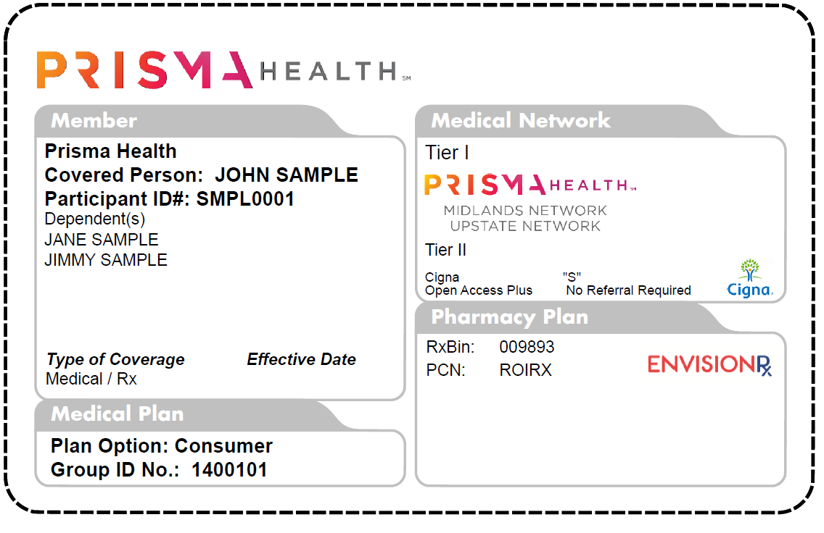
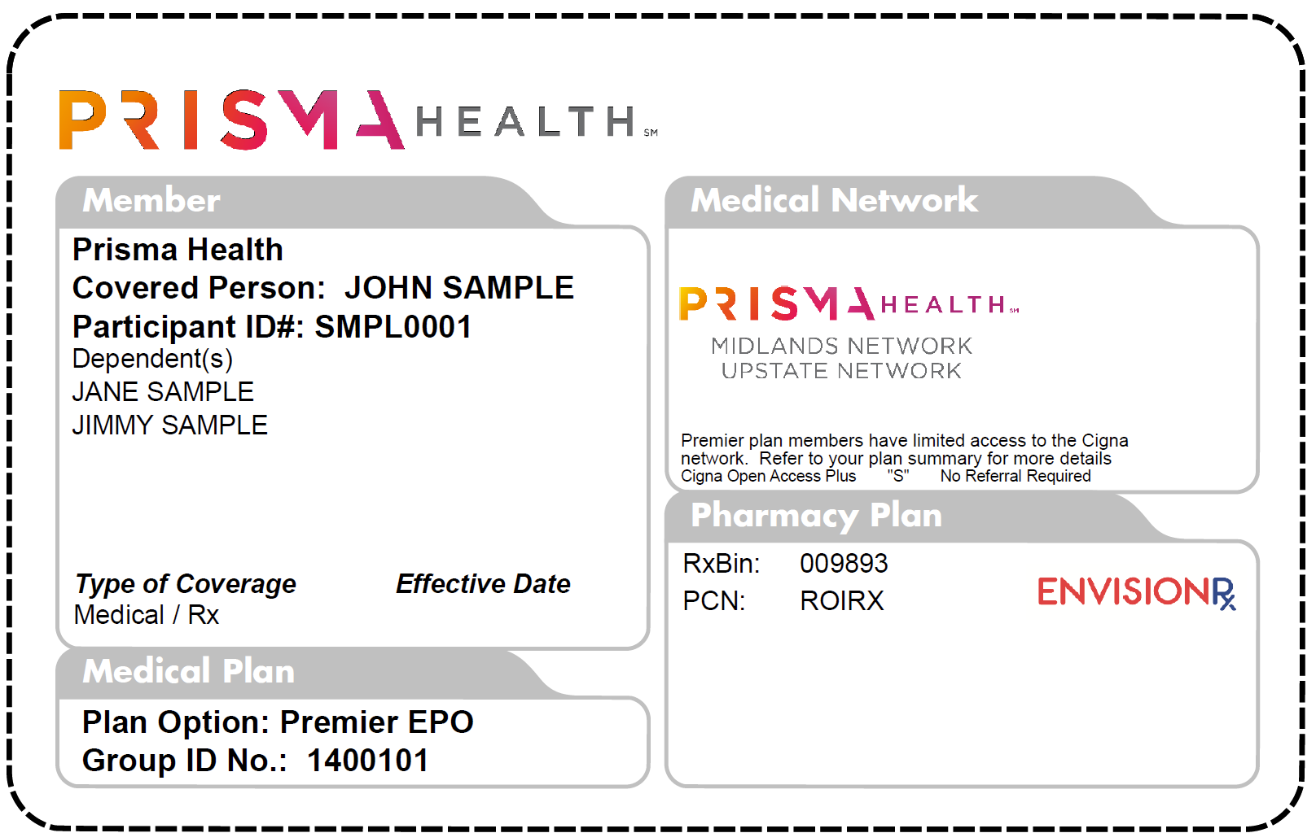
New Member Identification Cards
Sample ID Card (front)

Slide 14
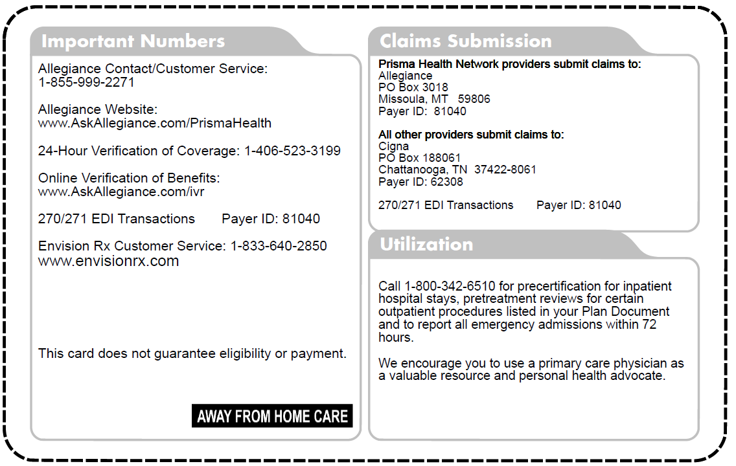
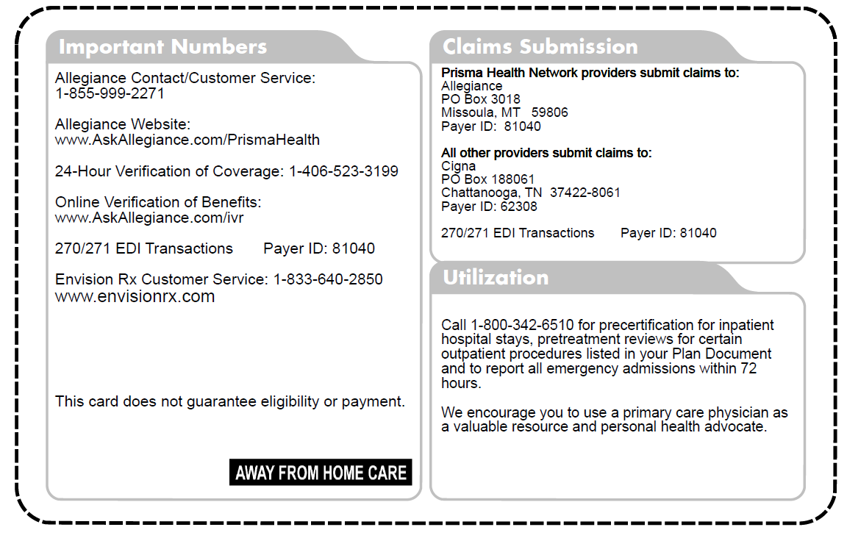
New Member Identification Cards
Sample ID Card (back)

